Slide 1

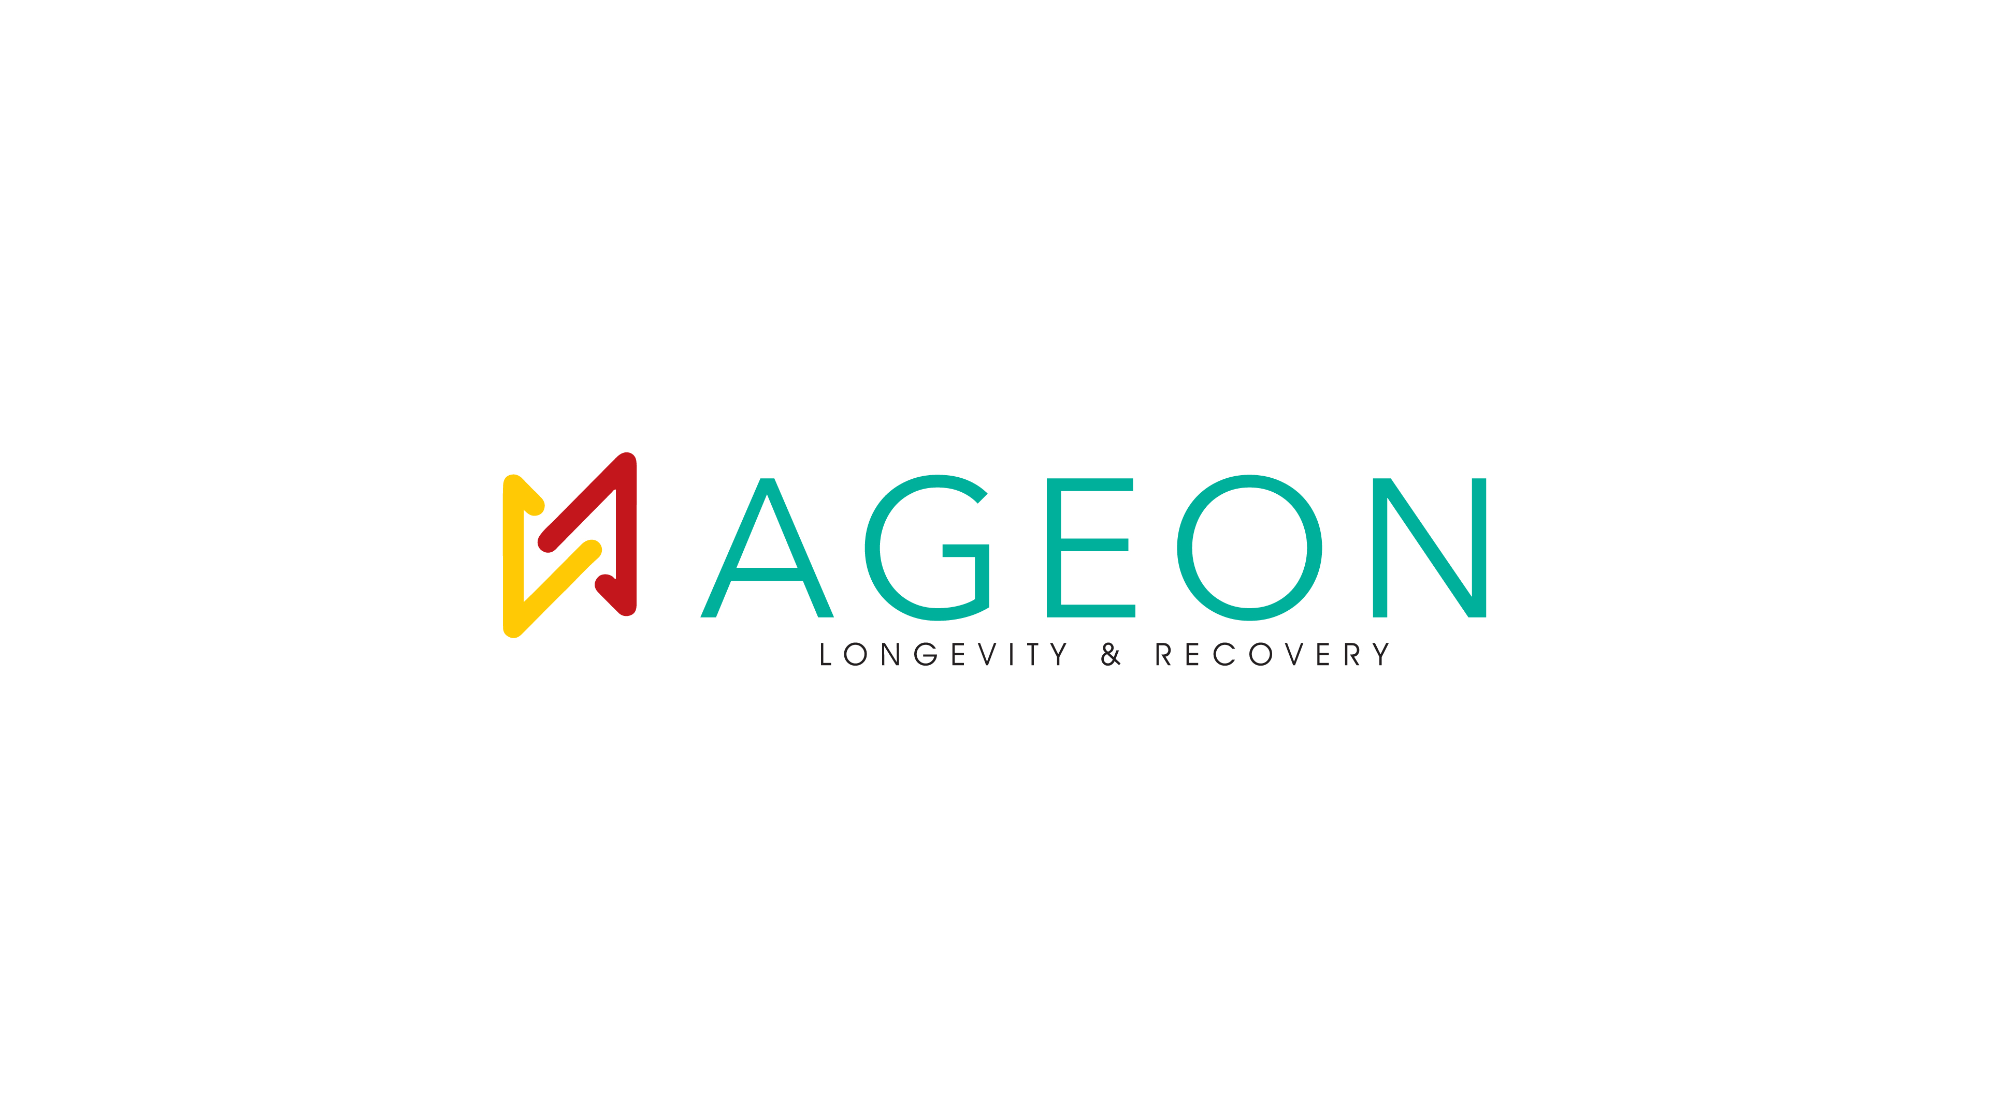
WHAT AGEON IS & WHAT AGEON DOES
What AGEON Is
What AGEON Does
AGEON is India’s Smart-Ageing & Longevity Platform—a category-defining system built to transform how people experience health, ageing, and performance. It is not a wellness clinic and not a collection of therapies. AGEON is a protocol-driven, science-backed longevity system designed for measurable health outcomes and long-term vitality.
AGEON integrates diagnostics, therapies, protocols, and tracking into one seamless ecosystem.
1. Protocol-Led Longevity System
2. Integrated Diagnostics Engine
AGEON does not sell random treatments. It delivers structured, outcome-driven protocols.
AGEON begins with deep health measurement, not assumptions. This creates a true biological baseline, enabling precision-driven care.
AGEON exists because:
India is living longer, but not healthier. Modern lifestyles are accelerating: • Fatigue & burnout • Metabolic dysfunction • Poor recovery • Hormonal imbalance • Early ageing Most people act only after symptoms appear. AGEON shifts this paradigm to preventive, proactive, and performance-led health.
3. Therapy Stack (Delivered via Protocols)
4. The AGEON Journey (Structured System)
Therapies are not sold in isolation, but assigned based on need.
Every member follows a defined transformation pathway: Assessment → Full diagnostic baseline Protocol Assignment → Personalized roadmap Guided Delivery → Expert-led therapies Tracking & Optimization → Continuous improvement This ensures measurable outcomes, not guesswork.
5. Membership-First Model
AGEON is built on continuity, not one-time visits. This makes AGEON a lifestyle system—not a service center.

Slide 2
PURPOSE, VISION & SCIENCE BEHIND AGEON
The Purpose
The Vision
AGEON’s purpose is clear: To shift healthcare from reactive treatment to proactive longevity. It focuses on: • Extending healthspan (not just lifespan) • Preventing disease before it appears • Enhancing physical, mental, and metabolic performance
AGEON is building: India’s Longevity Infrastructure Not a clinic chain. Not a therapy brand. But a national platform for smart-ageing and preventive health. The long-term vision includes: • Multi-city expansion (flagship → metro → tier 2 → corporate) • Standardized, scalable wellness systems • A premium, trust-driven health ecosystem
The Science Behind AGEON
AGEON is built on a data-driven, cellular-level health model.
1. Integrated Health Measurement
2. Cellular & Functional Optimization
3. Protocol-Based Clinical Logic
4. Measurable Outcomes & Optimization
AGEON tracks key biological systems: • Metabolic health (energy, glucose, body composition) • Cardiovascular risk (endurance, early indicators) • Biological ageing (cellular decline, vitality markers) • Inflammation & recovery (stress load, resilience) This creates a 360° view of human health, not fragmented insights.
AGEON targets root causes of ageing: • Cellular damage • Oxygen inefficiency • Chronic inflammation • Metabolic imbalance Therapies are designed to: • Improve cellular repair • Enhance mitochondrial efficiency • Boost recovery and resilience
Unlike traditional wellness: • No random treatments • No session-based approach AGEON follows: • Doctor-led intake • Data-driven decision systems • Standardized clinical pathways • Continuous outcome tracking
AGEON ensures: • Continuous tracking • Protocol refinement • Long-term performance visibility This transforms wellness into a measurable, repeatable system.

